Slide 1
Perpetual Motion
Gregory Harrison | CS 4395
Final Project | Monday, August 3, 2015

Slide 2
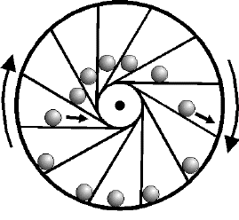
What is it?
Define: a state in which movement or action is or appears to be continuous and unceasing.

Slide 3
Rendering
process of generating an image from a 2D or 3D model (or models in what collectively could be called a scene file), by means of computer programs.
Geometry Object
Viewpoint
Texture
Lighting
Shading

Slide 4
Scene Graphs
The idea of modeling hierarchy extended to an entire scene, including:
Different objects
Lights
Camera
Scene
Camera
Background
Main Object
Light
Object Parts

Slide 5
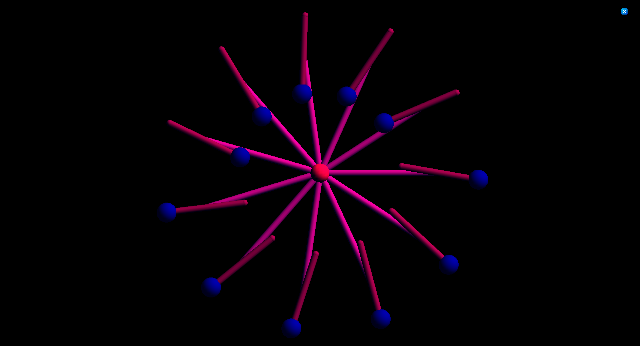
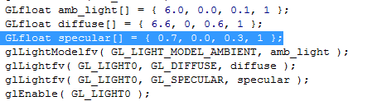
Lighting
Added
Ambient
Diffuse
Specular light

Slide 6
Geometric Objects
Everything that is in the object has been made for an geometric shape.
Sphere
Center, balance and the Shoulder joints
Cylinder
Shoulders and Levers

Slide 7
Interaction
Increase and decrease the amount of lever using the mouse wheel or up and down arrows keyboard keys, and rotate picture with left and right keys or mouse

Slide 8
Transformation
When the joint reach a certain point
When the lever moves closer to the bottom they adjust to the movement
When the lever starts making its way back to the top it makes a slight shift
The rotation of the object
Also adjust when adding more levers to the shape.

Slide 9
Shading
The shading for everything in the main object is smooth and sharp.

Slide 10
Modeling Hierarchy
The order in which the object appear is import so that the lever only connects to a joint, disconnecting any piece would leave the wheel unbalanced.

Slide 11
Projection
The perspective of the object is orthographic meaning that the object is set in stone and doesn’t seems as if its getting larger.

Slide 12
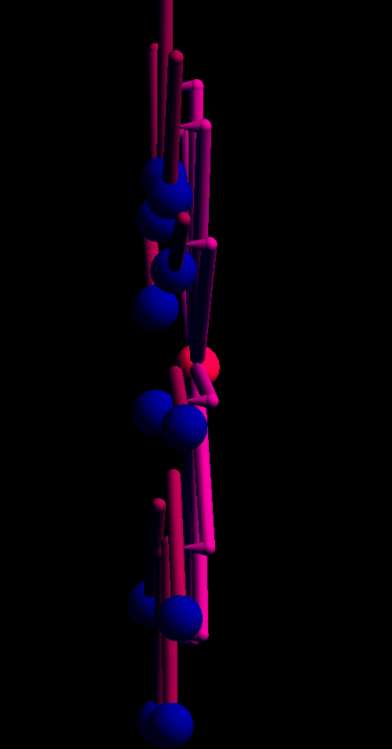
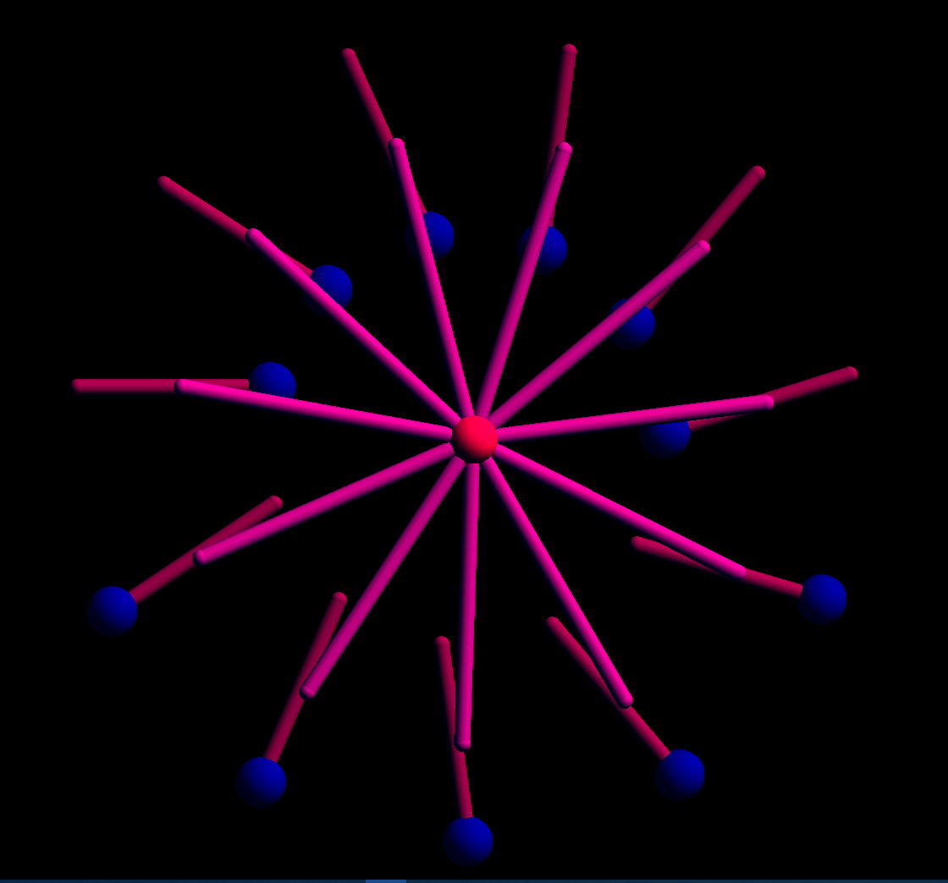
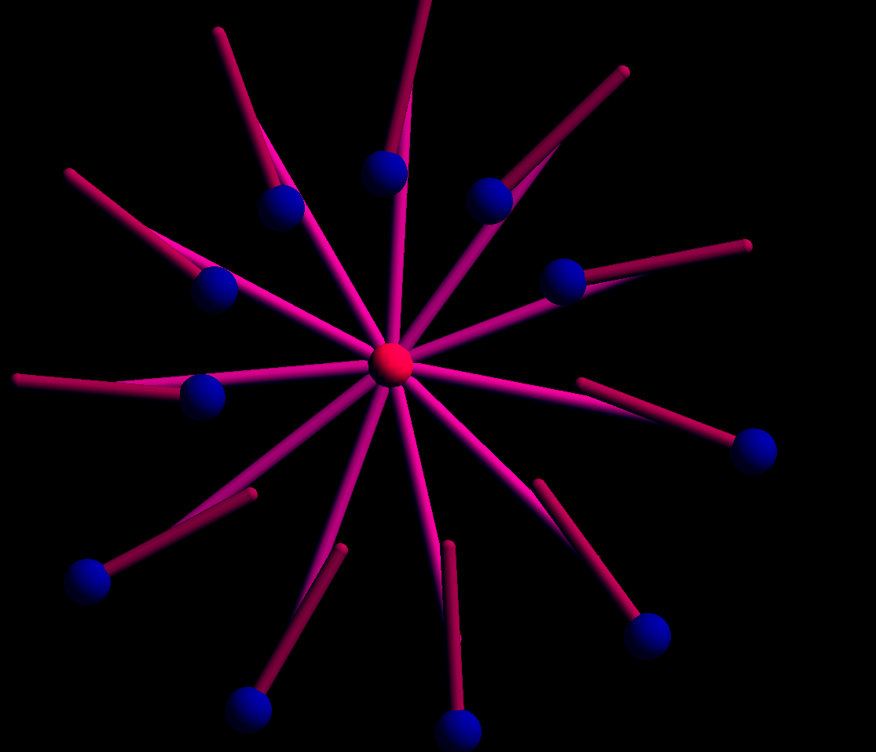
Clipping
You are able to move the camera to see the front, back and side view of the object.

Slide 13
Source
Code written by Sergey Matveyev
http://www.codeproject.com/Articles/13141/Perpetuum-Mobile

Slide 14
Questions?

